Slide 1

Abstineatis Process Mining
Business process analytics for the developing world

Slide 2
What is process mining?
Operations
Often tracked or hosted on IT platforms.
Transparent and accurate analytics
Process Mining
Algorithms used to analyse the performance of real world processes.

Slide 3
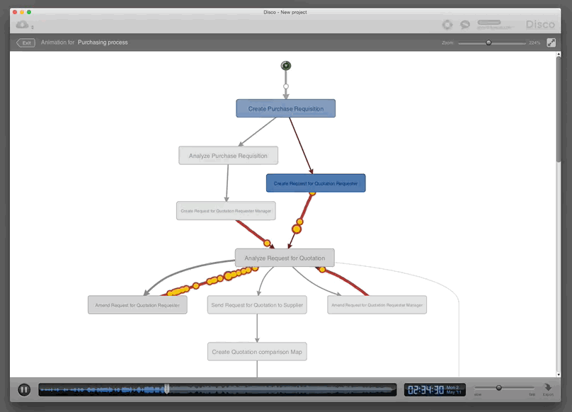
What is process mining?
Transparent and accurate analytics
Image courtesy of: Disco Process Mining

Slide 4
Value Proposition
Hardware Consulting
Software Supply
Companies looking to upgrade their operations or business processes
Process mining software to improve visibility over processes
Training
Train analysts in the use of software

Slide 5
Competitors

Slide 6
Conclusion

